Slide 1
Chapter 6 Linear Transformations
6.1 Introduction to Linear Transformations
6.2 The Kernel and Range of a Linear Transformation
6.3 Matrices for Linear Transformations
6.4 Transition Matrices and Similarity
6.5 Applications of Linear Transformations
6.1

Slide 2
6.1 Introduction to Linear Transformations
A function T that maps a vector space V into a vector space W:
V: the domain (定義域) of T W: the codomain (對應域) of T
Image of v under T (在T映射下v的像):
If v is a vector in V and w is a vector in W such that
then w is called the image of v under T
(For each v, there is only one w)
The range of T (T的值域):
The set of all images of vectors in V (see the figure on the next slide)

Slide 3
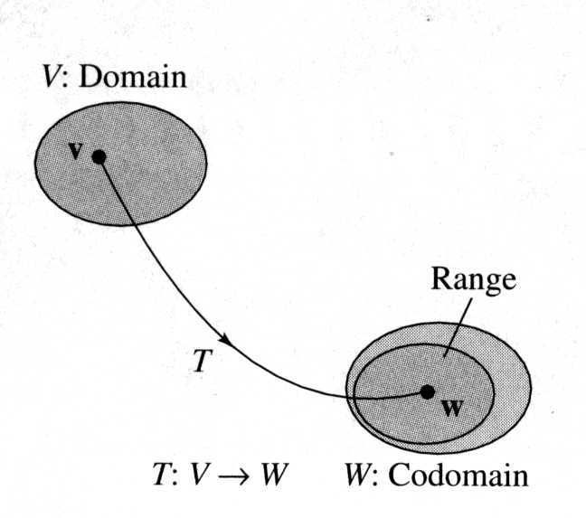
The preimage of w (w的反像):
The set of all v in V such that T(v)=w
(For each w, v may not be unique)
The graphical representations of the domain, codomain, and range
※ For example, V is R³, W is R³, and T is the orthogonal projection of any vector (x, y, z) onto the xy-plane, i.e. T(x, y, z) = (x, y, 0)
(we will use the above example many times to explain abstract notions)
※ Then the domain is R³, the codomain is R³, and the range is xy-plane (a subspace of the codomian R³)
※ (2, 1, 0) is the image of (2, 1, 3)
※ The preimage of (2, 1, 0) is (2, 1, s), where s is any real number

Slide 4
Ex 1: A function from R² into R²
(a) Find the image of v=(-1,2) (b) Find the preimage of w=(-1,11)
Sol:
Thus {(3, 4)} is the preimage of w=(-1, 11)

Slide 5
Linear Transformation (線性轉換):

Slide 6
Notes:
(1) A linear transformation is said to be operation preserving
(because the same result occurs whether the operations of addition and scalar multiplication are performed before or after the linear transformation is applied)
Addition in V
Addition in W
Scalar multiplication in V
Scalar multiplication in W
(2) A linear transformation from a vector space into itself is called a linear operator (線性運算子)

Slide 7
Ex 2: Verifying a linear transformation T from R² into R²
Pf:

Slide 8
Therefore, T is a linear transformation

Slide 9
Ex 3: Functions that are not linear transformations
(f(x) = sin x is not a linear transformation)
(f(x) = x² is not a linear transformation)
(f(x) = x+1 is not a linear transformation, although it is a linear function)

Slide 10
Notes: Two uses of the term “linear”.
(1) is called a linear function because its graph is a line
(2) is not a linear transformation from a vector space R into R because it preserves neither vector addition nor scalar multiplication

Slide 11
Zero transformation (零轉換):
Identity transformation (相等轉換):
Theorem 6.1: Properties of linear transformations
(T(cv) = cT(v) for c=0)
(T(cv) = cT(v) for c=-1)
(T(u+(-v))=T(u)+T(-v) and property (2))
(Iteratively using T(u+v)=T(u)+T(v) and T(cv) = cT(v))

Slide 12
Ex 4: Linear transformations and bases
Let be a linear transformation such that
Find T(2, 3, -2)
Sol:

Slide 13
Ex 5: A linear transformation defined by a matrix
The function is defined as
Sol:
(vector addition)
(scalar multiplication)

Slide 14
Theorem 6.2: The linear transformation defined by a matrix
Let A be an m×n matrix. The function T defined by
is a linear transformation from R^{n} into R^{m}
Note:
※ If T(v) can represented by Av, then T is a linear transformation
※ If the size of A is m×n, then the domain of T is R^{n} and the codomain of T is R^{m}

Slide 15
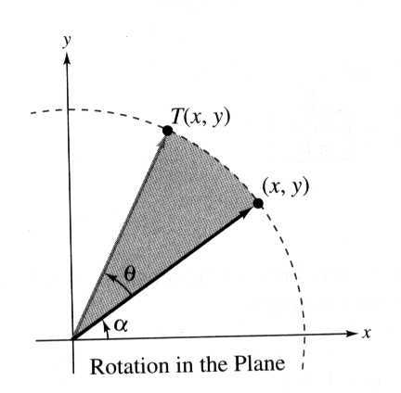
Ex 7: Rotation in the plane
Show that the L.T. given by the matrix
has the property that it rotates every vector in R² counterclockwise about the origin through the angle θ
Sol:
(Polar coordinates: for every point on the xy-plane, it can be represented by a set of (r, α))
r：the length of v ( )
α：the angle from the positive x-axis counterclockwise to the vector v
T(v)
v

Slide 16
according to the addition formula of trigonometric identities (三角函數合角公式)
r：remain the same, that means the length of T(v) equals the
length of v
θ +α：the angle from the positive x-axis counterclockwise to
the vector T(v)
Thus, T(v) is the vector that results from rotating the vector v counterclockwise through the angle θ

Slide 17
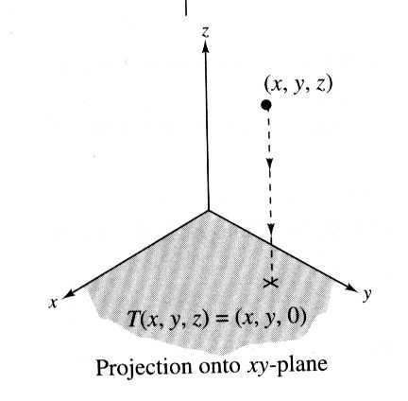
Ex 8: A projection in R³
The linear transformation is given by
is called a projection in R³
※ In other words, T maps every vector in R³ to its orthogonal projection in the xy-plane, as shown in the right figure

Slide 18
Ex 9: The transpose function is a linear transformation from M_{m×n} into M_{n ×m}
Show that T is a linear transformation
Sol:
Therefore, T (the transpose function) is a linear transformation from M_{m×n} into M_{n×m}

Slide 19
Keywords in Section 6.1:
function: 函數
domain: 定義域
codomain: 對應域
image of v under T: 在T映射下v的像
range of T: T的值域
preimage of w: w的反像
linear transformation: 線性轉換
linear operator: 線性運算子
zero transformation: 零轉換
identity transformation: 相等轉換

Slide 20
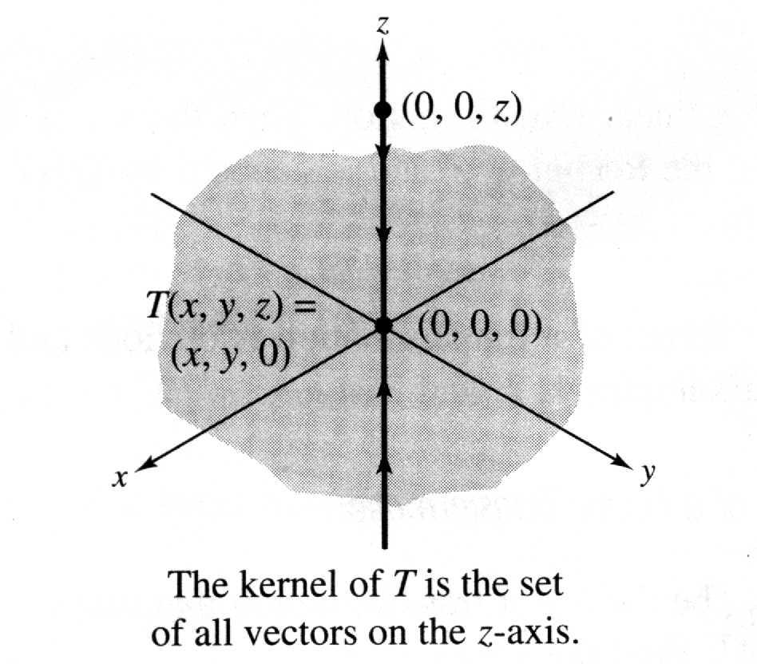
6.2 The Kernel and Range of a Linear Transformation
Kernel of a linear transformation T (線性轉換T的核空間):
Let be a linear transformation. Then the set of all vectors v in V that satisfy is called the kernel of T and is denoted by ker(T)
※ For example, V is R³, W is R³, and T is the orthogonal projection of any vector (x, y, z) onto the xy-plane, i.e. T(x, y, z) = (x, y, 0)
※ Then the kernel of T is the set consisting of (0, 0, s), where s is a real number, i.e.

Slide 21
Ex 1: Finding the kernel of a linear transformation
Sol:
Ex 2: The kernel of the zero and identity transformations
(a) If T(v) = 0 (the zero transformation ), then
(b) If T(v) = v (the identity transformation ), then

Slide 22
Ex 5: Finding the kernel of a linear transformation
Sol:

Slide 24
Theorem 6.3: The kernel is a subspace of V
The kernel of a linear transformation is a subspace of the domain V
Pf:
T is a linear transformation

Slide 25
Ex 6: Finding a basis for the kernel
Find a basis for ker(T) as a subspace of R⁵
Sol:
To find ker(T) means to find all x satisfying T(x) = Ax = 0.
Thus we need to form the augmented matrix first

Slide 27
Corollary to Theorem 6.3:
※ The kernel of T equals the nullspace of A (which is defined in Theorem 4.16 on p.239) and these two are both subspaces of R^{n} )
※ So, the kernel of T is sometimes called the nullspace of T

Slide 28
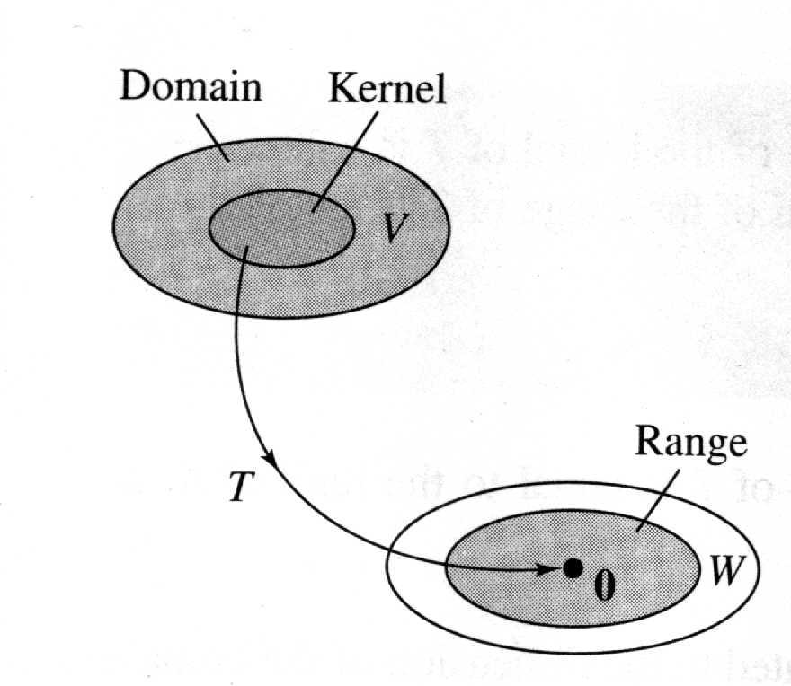
Range of a linear transformation T (線性轉換T的值域):
※ For the orthogonal projection of any vector (x, y, z) onto the xy-plane, i.e. T(x, y, z) = (x, y, 0)
※ The domain is V=R³, the codomain is W=R³, and the range is xy-plane (a subspace of the codomian R³)
※ Since T(0, 0, s) = (0, 0, 0) = 0, the kernel of T is the set consisting of (0, 0, s), where s is a real number

Slide 29
Theorem 6.4: The range of T is a subspace of W
Pf:
T is a linear transformation

Slide 30
Notes:
(Theorem 6.3)
(Theorem 6.4)

Slide 31
Corollary to Theorem 6.4:
(1) According to the definition of the range of T(x) = Ax, we know that the range of T consists of all vectors b satisfying Ax=b, which is equivalent to find all vectors b such that the system Ax=b is consistent
(2) Ax=b can be rewritten as
Therefore, the system Ax=b is consistent iff we can find (x₁, x₂,…, x_{n}) such that b is a linear combination of the column vectors of A, i.e.
Thus, we can conclude that the range consists of all vectors b, which is a linear combination of the column vectors of A or said . So, the column space of the matrix A is the same as the range of T, i.e. range(T) = CS(A)

Slide 32
Use our example to illustrate the corollary to Theorem 6.4:
※ For the orthogonal projection of any vector (x, y, z) onto the xy-plane, i.e. T(x, y, z) = (x, y, 0)
※ According to the above analysis, we already knew that the range of T is the xy-plane, i.e. range(T)={(x, y, 0)| x and y are real numbers}
※ T can be defined by a matrix A as follows
※ The column space of A is as follows, which is just the xy-plane

Slide 33
Ex 7: Finding a basis for the range of a linear transformation
Find a basis for the range of T
Sol:
Since range(T) = CS(A), finding a basis for the range of T is equivalent to fining a basis for the column space of A

Slide 35
Rank of a linear transformation T:V→W (線性轉換T的秩):
According to the corollary to Thm. 6.4, range(T) = CS(A), so dim(range(T)) = dim(CS(A))
Nullity of a linear transformation T:V→W (線性轉換T的核次數):
According to the corollary to Thm. 6.3, ker(T) = NS(A), so dim(ker(T)) = dim(NS(A))
Note:
※ The dimension of the row (or column) space of a matrix A is called the rank of A
※ The dimension of the nullspace of A ( ) is called the nullity of A

Slide 36
Theorem 6.5: Sum of rank and nullity
Let T: V →W be a linear transformation from an n-dimensional vector space V (i.e. the dim(domain of T) is n) into a vector space W. Then
※ You can image that the dim(domain of T) should equals the dim(range of T) originally
※ But some dimensions of the domain of T is absorbed by the zero vector in W
※ So the dim(range of T) is smaller than the dim(domain of T) by the number of how many dimensions of the domain of T are absorbed by the zero vector, which is exactly the dim(kernel of T)

Slide 37
Pf:
according to Thm. 4.17 where rank(A) + nullity(A) = n
※ Here we only consider that T is represented by an m×n matrix A. In the next section, we will prove that any linear transformation from an n-dimensional space to an m-dimensional space can be represented by m×n matrix

Slide 38
Ex 8: Finding the rank and nullity of a linear transformation
Sol:
※ The rank is determined by the number of leading 1’s, and the nullity by the number of free variables (columns without leading 1’s)

Slide 39
Ex 9: Finding the rank and nullity of a linear transformation
Sol:

Slide 40
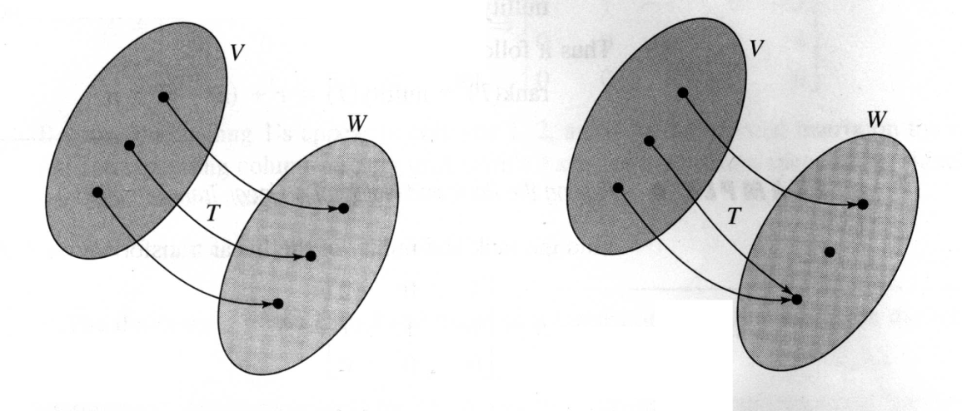
One-to-one (一對一):
one-to-one
not one-to-one

Slide 41
Theorem 6.6: One-to-one linear transformation
Pf:
Due to the fact that T(0) = 0 in Thm. 6.1
T is a linear transformation, see Property 3 in Thm. 6.1

Slide 42
Ex 10: One-to-one and not one-to-one linear transformation
because its kernel consists of only the m×n zero matrix
because its kernel is all of R³

Slide 43
Onto (映成):
(T is onto W when W is equal to the range of T)
Theorem 6.7: Onto linear transformations
Let T: V → W be a linear transformation, where W is finite dimensional. Then T is onto if and only if the rank of T is equal to the dimension of W
The definition of the rank of a linear transformation
The definition of onto linear transformations

Slide 44
Theorem 6.8: One-to-one and onto linear transformations
Pf:
According to the definition of dimension (on p.227) that if a vector space V consists of the zero vector alone, the dimension of V is defined as zero

Slide 45
Ex 11:
Sol:
= dim(range of T)
= # of leading 1’s
If nullity(T) = dim(ker(T)) = 0
If rank(T) = dim(R^{m}) = m
= dim(R^{n}) = n
= (1) – (2) = dim(ker(T))
T:R^{n}→R^{m} | dim(domain of T) (1) | rank(T) (2) | nullity(T) | 1-1 | onto
(a) T:R³→R³ | 3 | 3 | 0 | Yes | Yes
(b) T:R²→R³ | 2 | 2 | 0 | Yes | No
(c) T:R³→R² | 3 | 2 | 1 | No | Yes
(d) T:R³→R³ | 3 | 2 | 1 | No | No

Slide 46
Isomorphism (同構):
Theorem 6.9: Isomorphic spaces (同構空間) and dimension
Two finite-dimensional vector space V and W are isomorphic if and only if they are of the same dimension
Pf:
dim(V) = n

Slide 48
Since is a basis for V, {w₁, w₂,…w_{n}} is linearly independent, and the only solution for w=0 is c₁=c₂=…=c_{n}=0 So with w=0, the corresponding v is 0, i.e., ker(T) = {0}
By Theorem 6.5, we can derive that dim(range of T) = dim(domain of T) – dim(ker(T)) = n –0 = n = dim(W)
Since this linear transformation is both one-to-one and onto,
then V and W are isomorphic

Slide 49
Note
Theorem 6.9 tells us that every vector space with dimension n is isomorphic to R^{n}
Ex 12: (Isomorphic vector spaces)
The following vector spaces are isomorphic to each other

Slide 50
Keywords in Section 6.2:
kernel of a linear transformation T: 線性轉換T的核空間
range of a linear transformation T: 線性轉換T的值域
rank of a linear transformation T: 線性轉換T的秩
nullity of a linear transformation T: 線性轉換T的核次數
one-to-one: 一對一
onto: 映成
Isomorphism (one-to-one and onto): 同構
isomorphic space: 同構空間

Slide 51
6.3 Matrices for Linear Transformations
Two representations of the linear transformation T:R³→R³ :
Three reasons for matrix representation of a linear transformation:
It is simpler to write
It is simpler to read
It is more easily adapted for computer use

Slide 52
Theorem 6.10: Standard matrix for a linear transformation

Slide 53
Pf:

Slide 54
Note
Theorem 6.10 tells us that once we know the image of every vector in the standard basis (that is T(e_{i})), you can use the properties of linear transformations to determine T(v) for any v in V

Slide 55
Ex 1: Finding the standard matrix of a linear transformation
Sol:
Vector Notation Matrix Notation

Slide 56
Check:
Note: a more direct way to construct the standard matrix
※ The first (second) row actually represents the linear transformation function to generate the first (second) component of the target vector

Slide 57
Ex 2: Finding the standard matrix of a linear transformation
Sol:
Notes:
(1) The standard matrix for the zero transformation from R^{n} into R^{m} is the m×n zero matrix
(2) The standard matrix for the identity transformation from R^{n} into R^{n} is the n×n identity matrix I_{n}

Slide 58
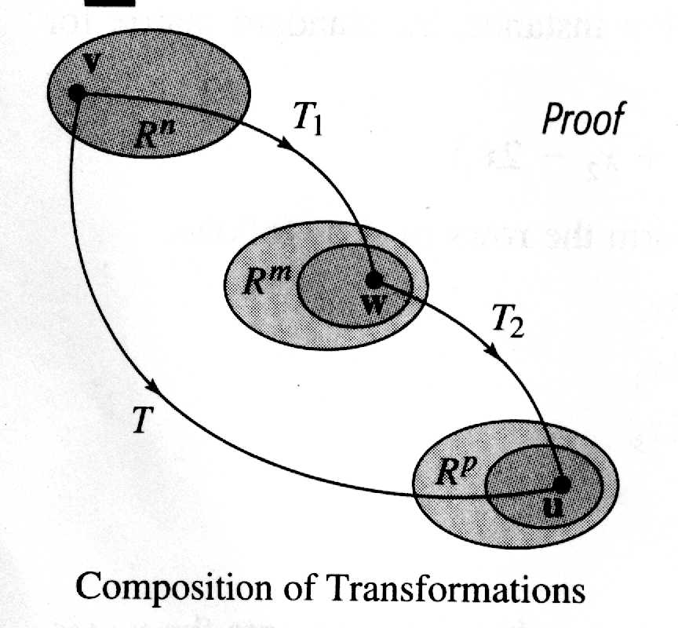
Composition of T₁:R^{n}→R^{m} with T₂:R^{m}→R^{p} :
Theorem 6.11: Composition of linear transformations (線性轉換的合成)

Slide 59
Pf:
Note:

Slide 60
Ex 3: The standard matrix of a composition
Sol:

Slide 62
Inverse linear transformation (反線性轉換):
Note:
If the transformation T is invertible, then the inverse is unique and denoted by T^{–1}

Slide 63
Theorem 6.12: Existence of an inverse transformation
※ For (2) ⇒ (1), you can imagine that since T is one-to-one and onto, for every w in the codomain of T, there is only one preimage v, which implies that T⁻¹(w) =v can be a L.T. and well-defined, so we can infer that T is invertible
※ On the contrary, if there are many preimages for each w, it is impossible to find a L.T to represent T⁻¹ (because for a L.T, there is always one input and one output), so T cannot be invertible
(1) T is invertible
(2) T is an isomorphism
(3) A is invertible
Note:
If T is invertible with standard matrix A, then the standard matrix for T^{–1} is A^{–1}

Slide 64
Ex 4: Finding the inverse of a linear transformation
Show that T is invertible, and find its inverse
Sol:

Slide 65
※ Check T⁻¹(T(2, 3, 4)) = T⁻¹(17, 19, 20) = (2, 3, 4)

Slide 66
The matrix of T relative to the bases B and B‘:
A matrix A can represent T if the result of A multiplied by a coordinate matrix of v relative to B is a coordinate matrix of v relative to B’, where B’ is a basis for W. That is,
where A is called the matrix of T relative to the bases B and B’ (T對應於基底B到B'的矩陣)

Slide 67
Transformation matrix for nonstandard bases (the generalization of Theorem 6.10, in which standard bases are considered) :

Slide 68
※The above result state that the coordinate of T(v) relative to the basis B’ equals the multiplication of A defined above and the coordinate of v relative to the basis B.
※ Comparing to the result in Thm. 6.10 (T(v) = Av), it can infer that the linear transformation and the basis change can be achieved in one step through multiplying the matrix A defined above (see the figure on 6.74 for illustration)

Slide 69
Ex 5: Finding a matrix relative to nonstandard bases
Sol:

Slide 70
Ex 6:
Sol:
Check:

Slide 71
Notes:

Slide 72
Keywords in Section 6.3:
standard matrix for T: T 的標準矩陣
composition of linear transformations: 線性轉換的合成
inverse linear transformation: 反線性轉換
matrix of T relative to the bases B and B' : T對應於基底B到B'的矩陣
matrix of T relative to the basis B: T對應於基底B的矩陣

Slide 73
6.4 Transition Matrices and Similarity
(T相對於B的矩陣)
(T相對於B’的矩陣)
(從B'到B的轉移矩陣)
(從B到B’的轉移矩陣)
from the definition of the transition matrix on p.254 in the text book or on Slide 4.108 and 4.109 in the lecture notes

Slide 74
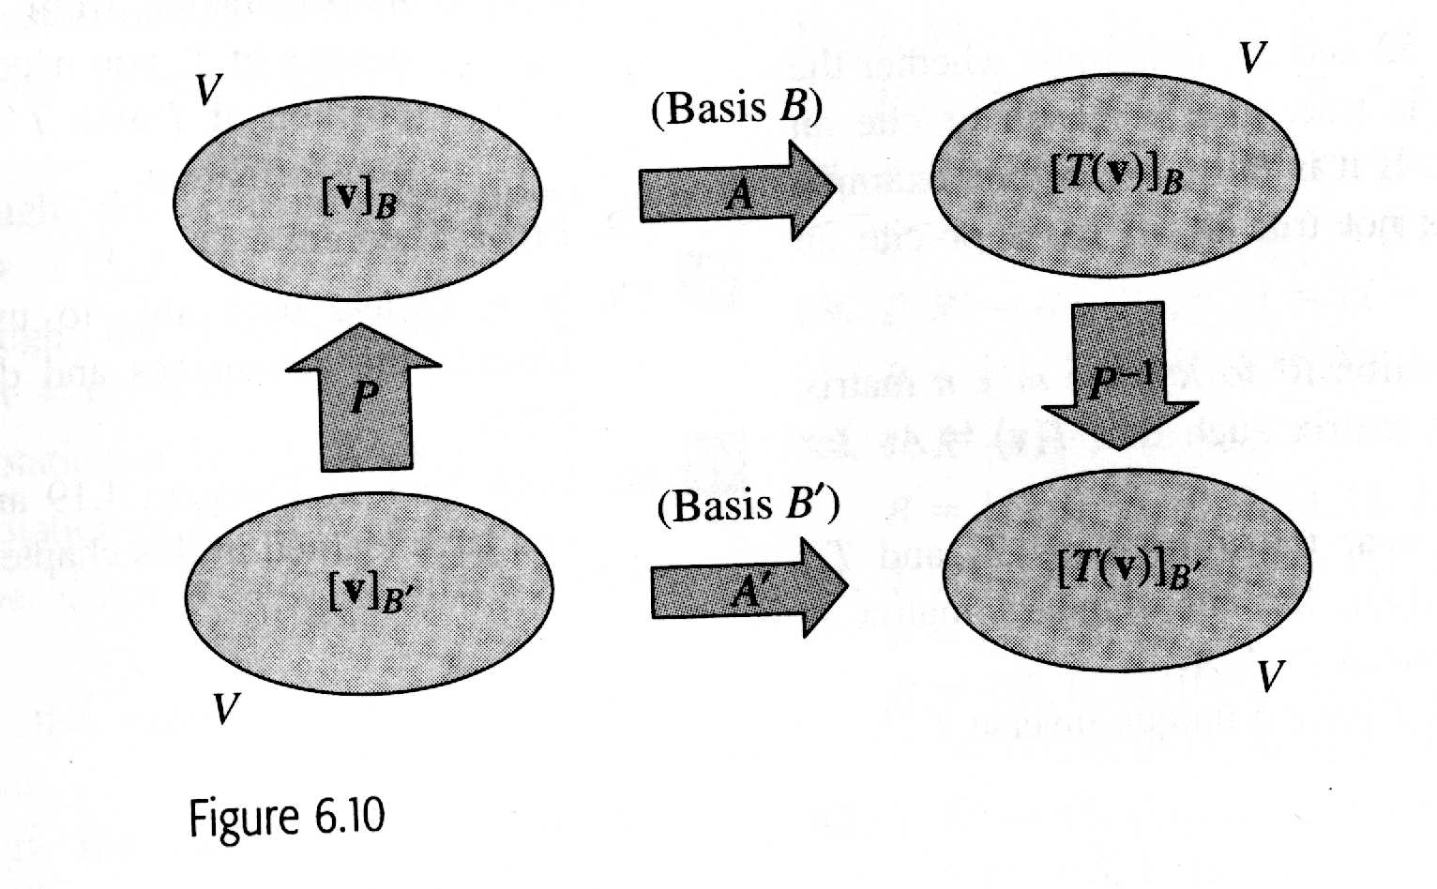
Two ways to get from to :

Slide 75
Ex 1: (Finding a matrix for a linear transformation)
Sol:

Slide 76
※ Solve a(1, 0) + b(0, 1) = (1, 0) ⇒ (a, b) = (1, 0)
※ Solve c(1, 0) + d(0, 1) = (1, 1) ⇒ (c, d) = (1, 1)
※ Solve a(1, 0) + b(1, 1) = (1, 0) ⇒ (a, b) = (1, 0)
※ Solve c(1, 0) + d(1, 1) = (0, 1) ⇒ (c, d) = (-1, 1)

Slide 77
Ex 2: (Finding a matrix for a linear transformation)
Sol:
Because the specific function is unknown, it is difficult to apply the direct method to derive A’, so we resort to the indirect method where A’ = P⁻¹AP

Slide 78
Ex 3: (Finding a matrix for a linear transformation)
Sol:

Slide 79
Similar matrix (相似矩陣):
For square matrices A and A’ of order n, A’ is said to be similar to A if there exist an invertible matrix P s.t. A’=P⁻¹AP
Theorem 6.13: (Properties of similar matrices)
Let A, B, and C be square matrices of order n.
Then the following properties are true.
(1) A is similar to A
(2) If A is similar to B, then B is similar to A
(3) If A is similar to B and B is similar to C, then A is similar to C
Pf for (1) and (2) (the proof of (3) is left in Exercise 23):

Slide 80
Ex 4: (Similar matrices)

Slide 81
Ex 5: (A comparison of two matrices for a linear transformation)
Sol:

Slide 82
(A’ is a diagonal matrix, which is simple and with some computational advantages)
※ You have seen that the standard matrix for a linear transformation T:V →V depends on the basis used for V. What choice of basis will make the standard matrix for T as simple as possible? This case shows that it is not always the standard basis.

Slide 83
Notes: Diagonal matrices have many computational advantages over nondiagonal ones (it will be used in the next chapter)

Slide 84
Keywords in Section 6.4:
matrix of T relative to B: T 相對於B的矩陣
matrix of T relative to B' : T 相對於B'的矩陣
transition matrix from B' to B : 從B'到B的轉移矩陣
transition matrix from B to B' : 從B到B'的轉移矩陣
similar matrix: 相似矩陣

Slide 85
6.5 Applications of Linear Transformation
The geometry of linear transformation in the plane (p.407-p.110)
Reflection in x-axis, y-axis, and y=x
Horizontal and vertical expansion and contraction
Horizontal and vertical shear
Computer graphics (to produce any desired angle of view of a 3-D figure)

